Slide 1
Casey Burgin

Slide 2
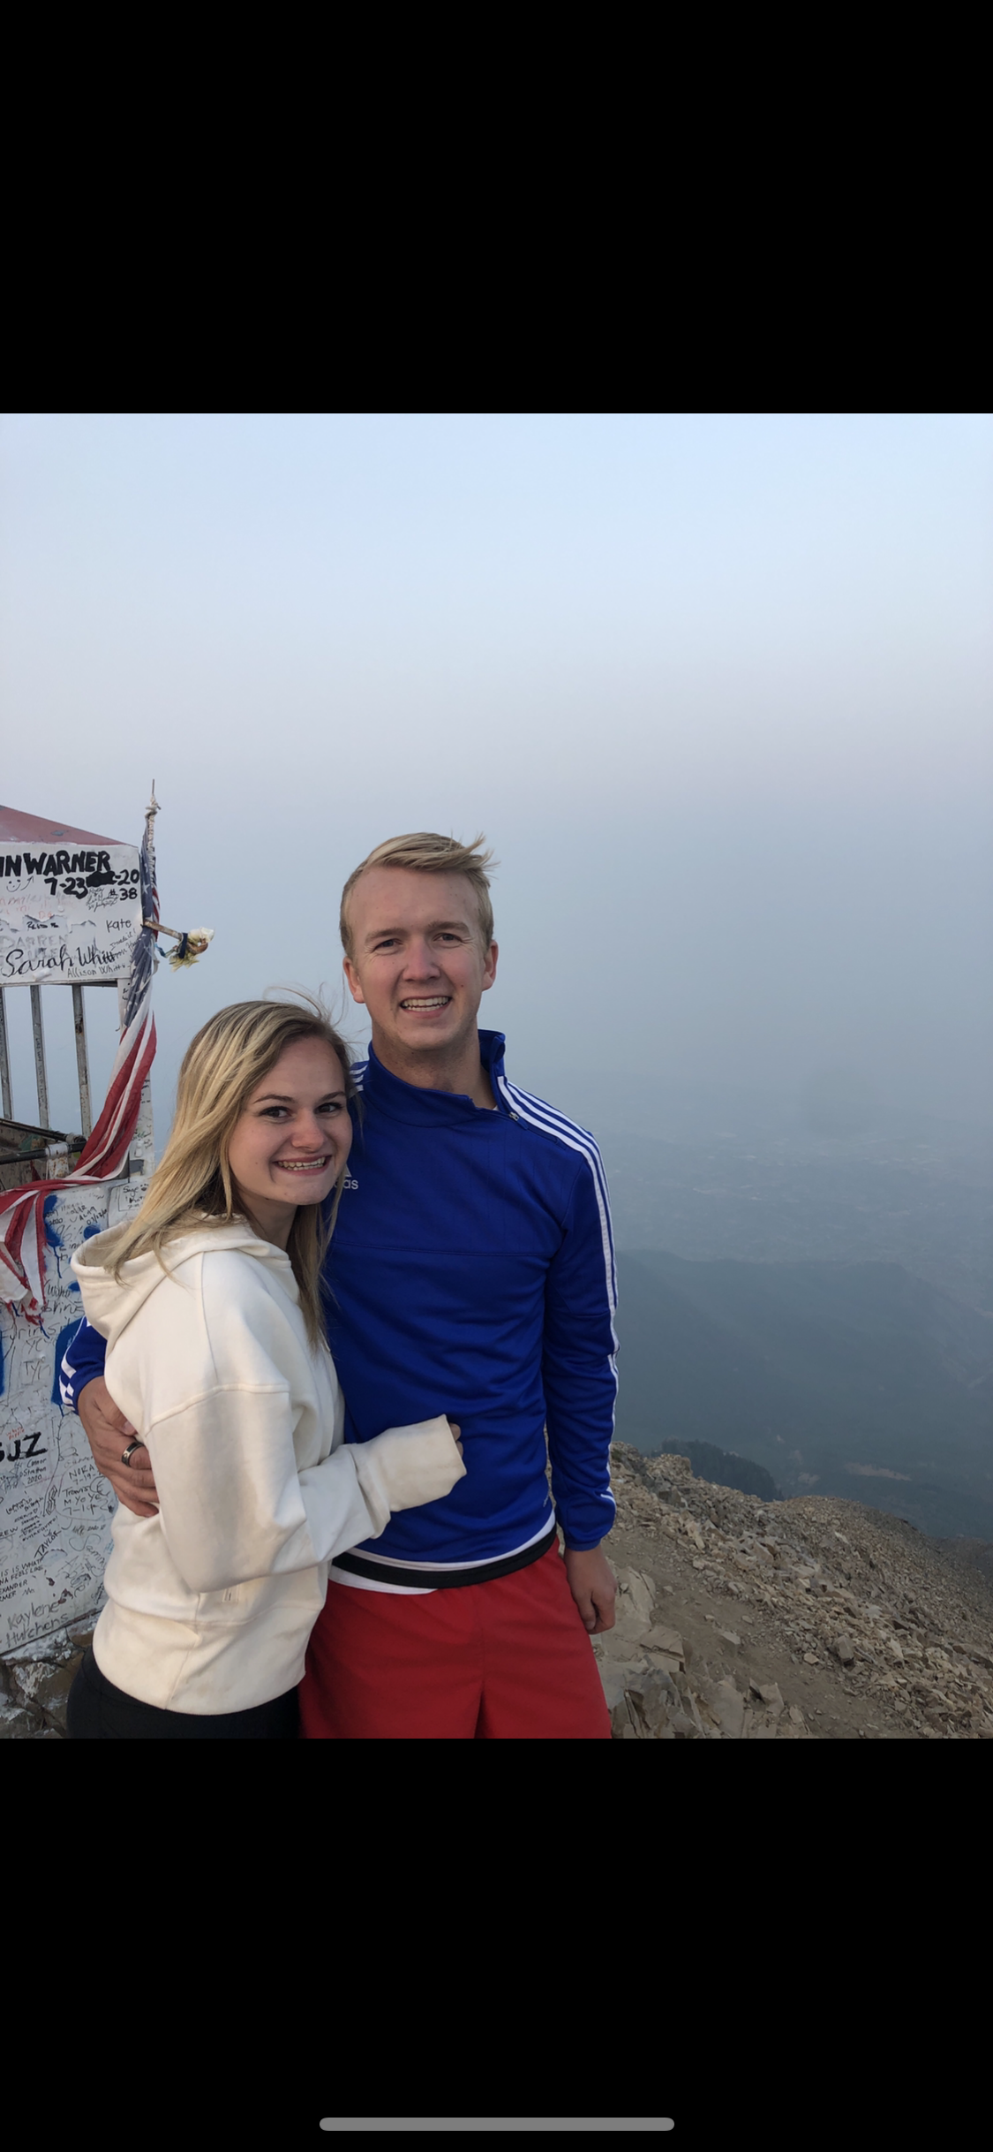
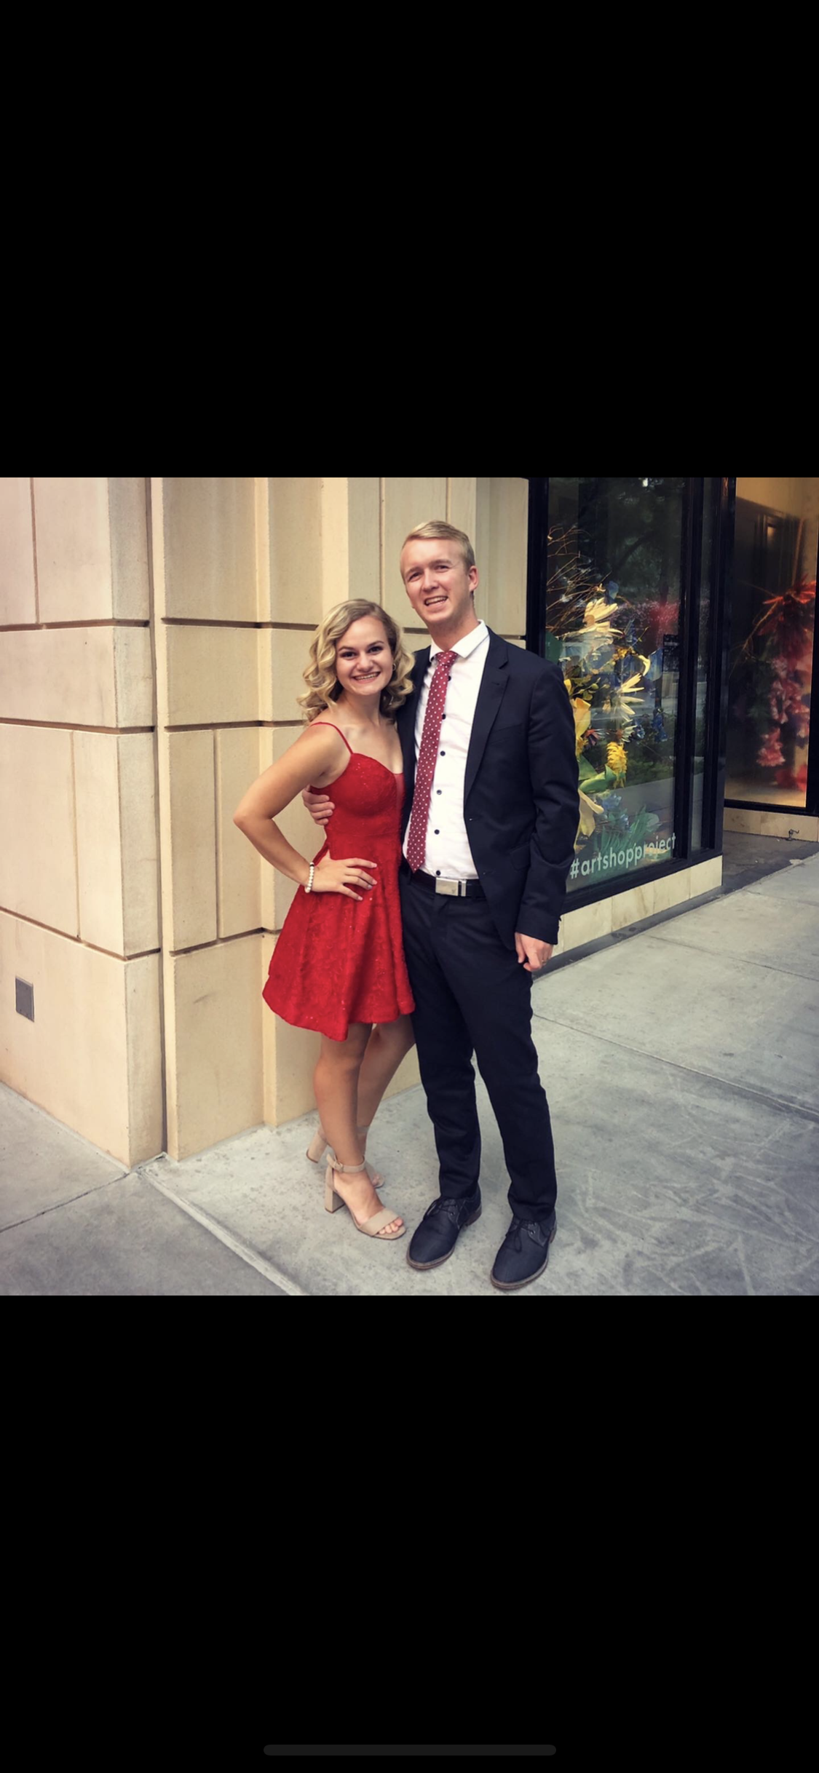
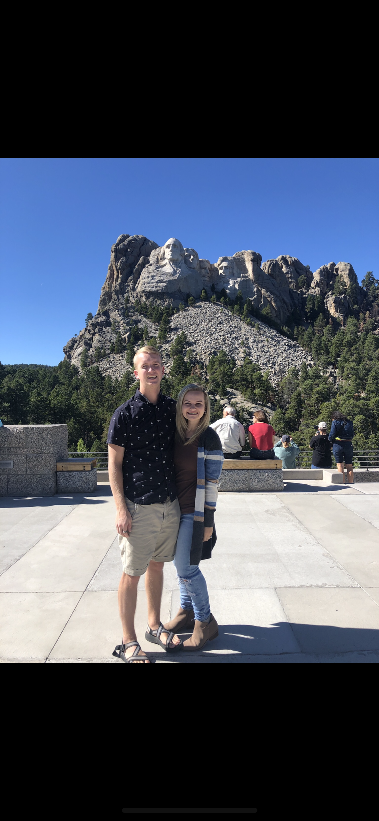
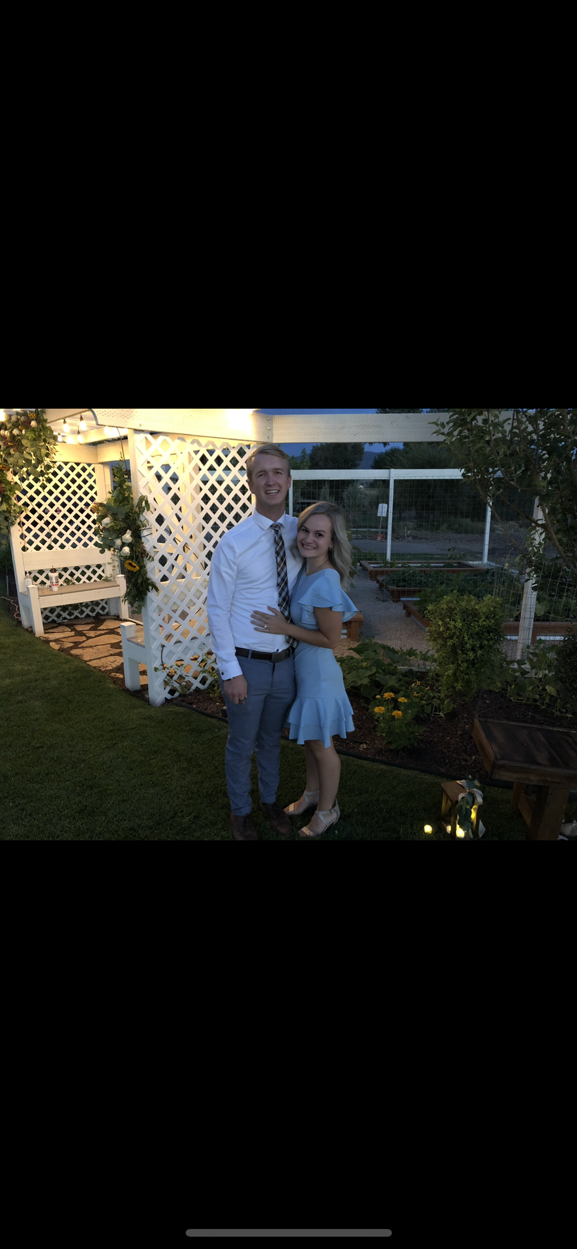
Recent adventures with Sammie
1. Hiking Timp 2. Date night 3. Friend’s wedding 4. Mt. Rushmore

Slide 3
School
Double Major: Accounting and Economics
Double Minor: MIS and Finance
Accounting: I have always loved numbers and like the preciseness of it
Economics: I loved Microeconomics and one class led to another
MIS: Felt it was important to know in the world we live in today
Finance: Why not? Pairs with Econ

Slide 4
Career goals
End goal: CFO/Controller type position
Next few years: MAcc, CPA
Work for Eide Bailly (Accounting)

Slide 5
Why Fin 5350?
It is a dual MIS + Finance credit that I need for graduation
I also have quite a bit of experience in Python/Data/Modeling so it seems interesting

Slide 6
Profound influential idea
Never sell yourself short
So often we have opportunities in front of us. Pushing ourselves out of our comfort zone makes the world a better place. It helps people develop talents and do things they never knew were possible.

Slide 7
Recent book: The happiness advantage
This book is so good! It really looks at where happiness comes from and how we can be happier on an individual basis.

Slide 8
Questions??

